Slide 1
ENERGY EFFICIENT AI CORE ON FPGA FOR POINT OF CARE APPLICATION
21
SUPERVISOR: Ms. FAUZIA YASIR
CO-SUPERVISOR: DR. MAJIDA KAZMI
Alauddin Taha Faya CS-19305 2.417
Rimsha Sohail CS-19051 3.299
Osamah Ameen Munasser CS-19306 1.717
Muhammad Shoaib CS-18301 2.035

Slide 2
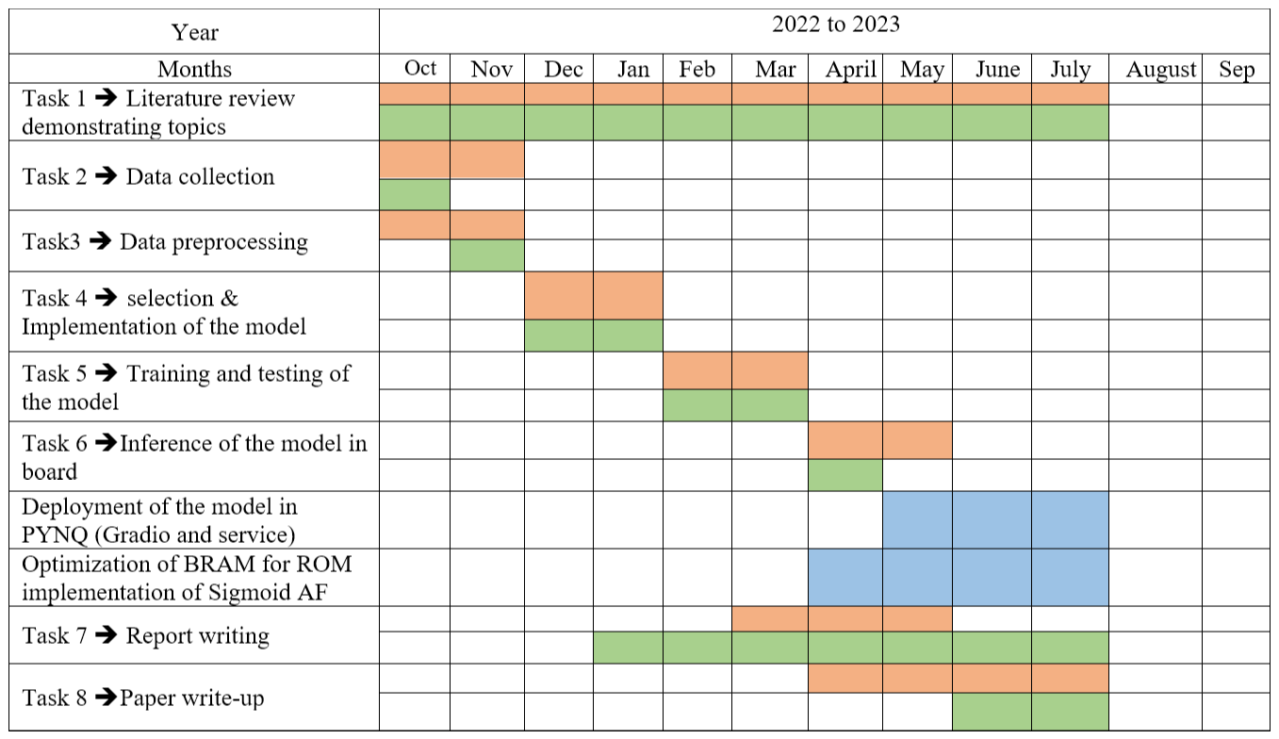
Gantt Chart
Proposed Gantt chart
Followed Gantt chart
Research work

Slide 3
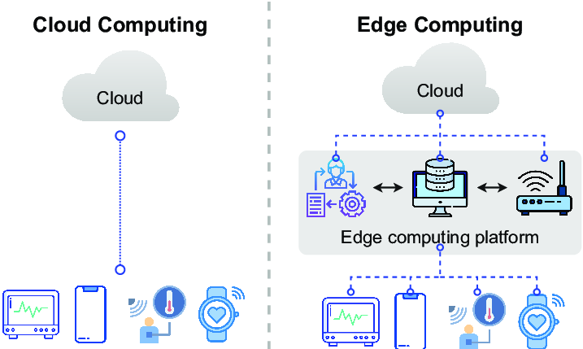

PROJECT INTRODUCTION
Our focus is to develop an autonomous AI core device at the Point of Care for Diabetic Eye Exam, screening for Diabetic Retinopathy.
Diabetic retinopathy screening can be done in two following ways:
On cloud such as AWS
On edge devices like PynQ,ZynQ ✔
✔

Slide 4
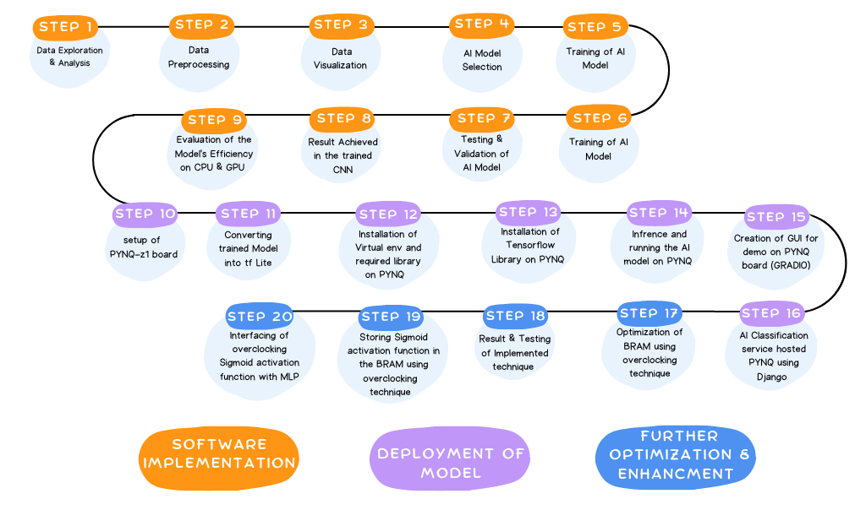
FLOW CHART

Slide 5
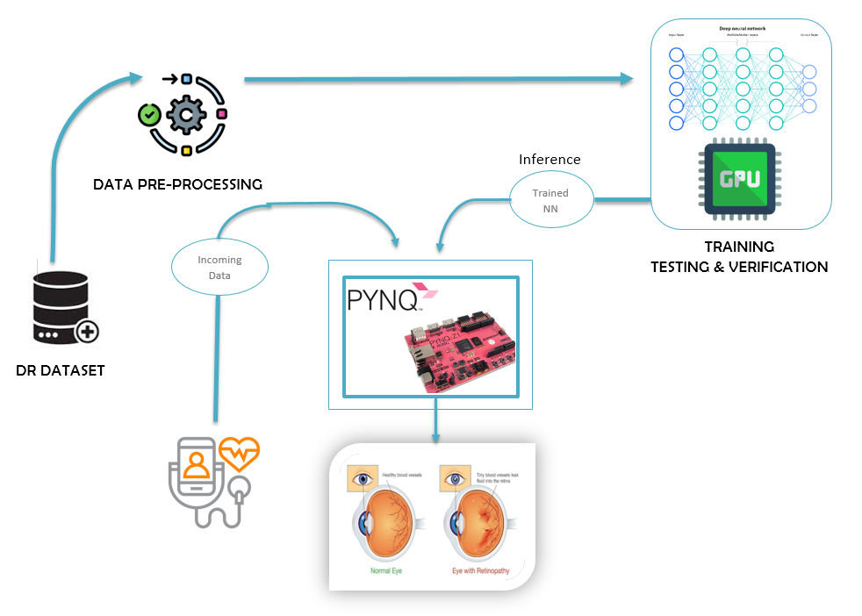
SOFTWARE IMPLEMENTATION

Slide 6
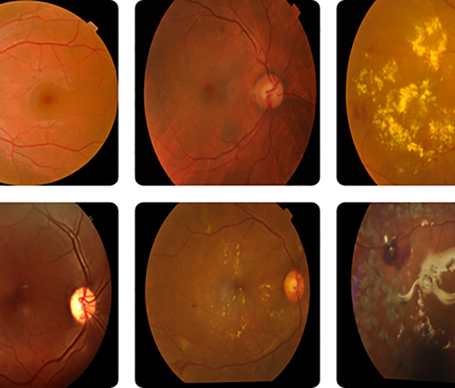

DATA SELECTION& EXPLORATORY DATA ANALYSIS
An online available standard dataset“DR APTOS”is selected for the task.
Link: https://www.kaggle.com/competitions/aptos2019-blindness-detection
The insights obtained are:
Total number of images present in dataset is “3662”.
Five classes No DR, Mild, Moderate, Severe and Proliferate.
Image distribution across categories: No DR (1805), Mild (999), Moderate (370), Severe (295), Proliferate (193).

Slide 7
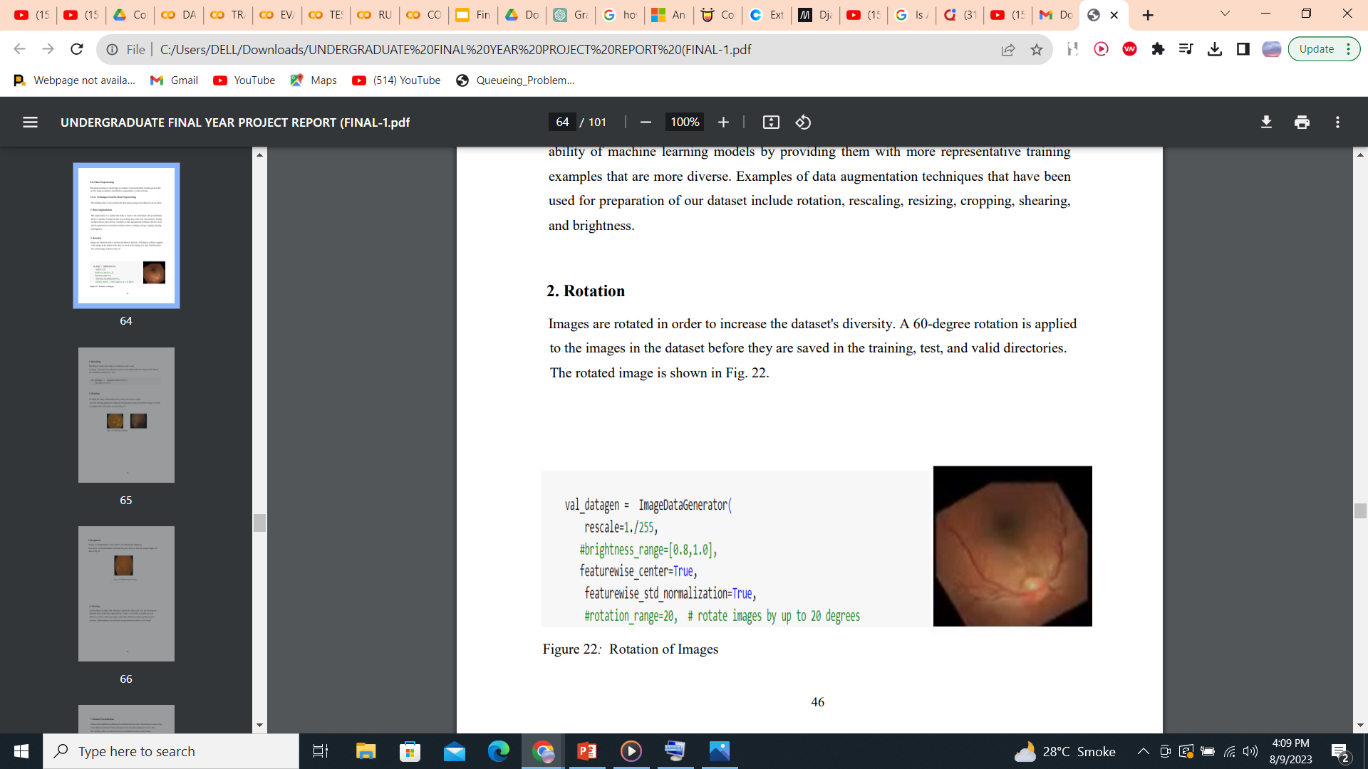
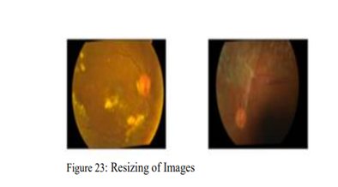
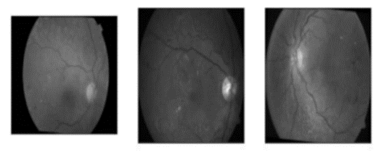

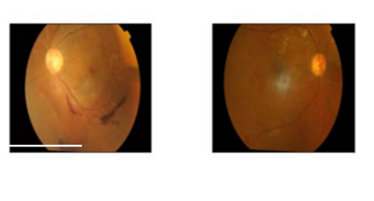
Data Preprocessing
Data preprocessing techniques that are applied to the dataset to produce a generalized model is given below:
After applying data preprocessing techniques on the dataset, we have prepared the sets for training, validation and testing.
Rotation
Brightening
Resizing of Images
Zooming
A standard split of 70% for training, 20% for validation, and 10% for testing is used for the preparation of datasets.
For binary classification:
2100 images are allocated to the Nrdr folder of the Train dataset.
600 images placed to the Nrdr folder of test dataset.
The Valid dataset's Rdr folder holds 600 images and the Nrdr folder in Valid dataset has 600 images.
Overall, there are 600 images for testing, 4200 for training, and 1200 for validation.
Rotation
Standard Normalization
Shearing
Rescaling

Slide 8
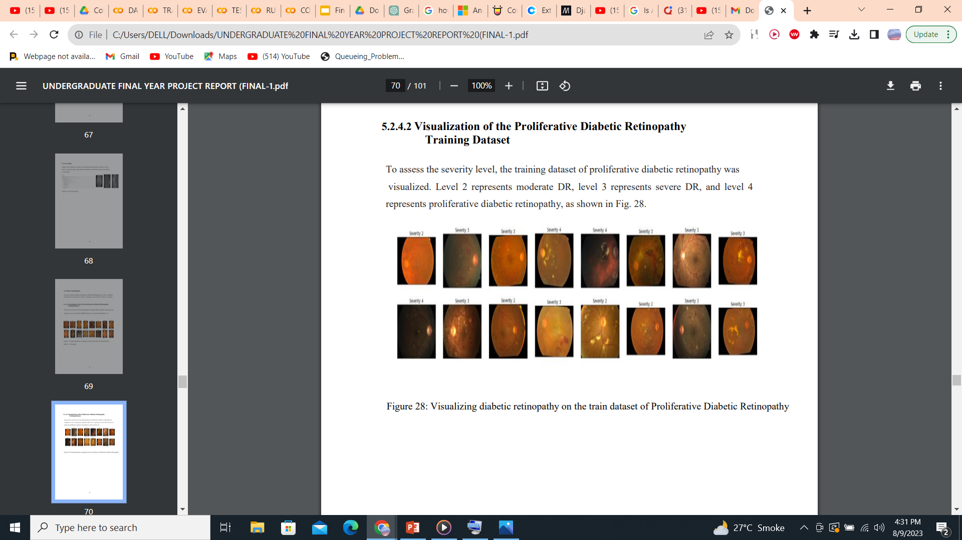
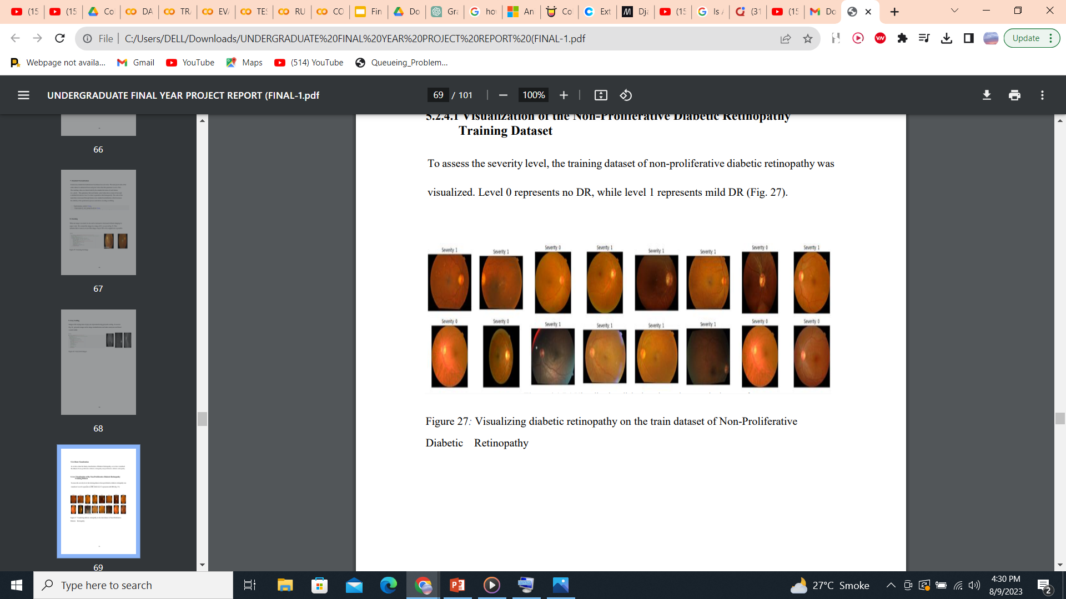
DATA VISUALIZATION
Data Visualization of Proliferative and Non-Proliferative DR Training Dataset

Slide 9
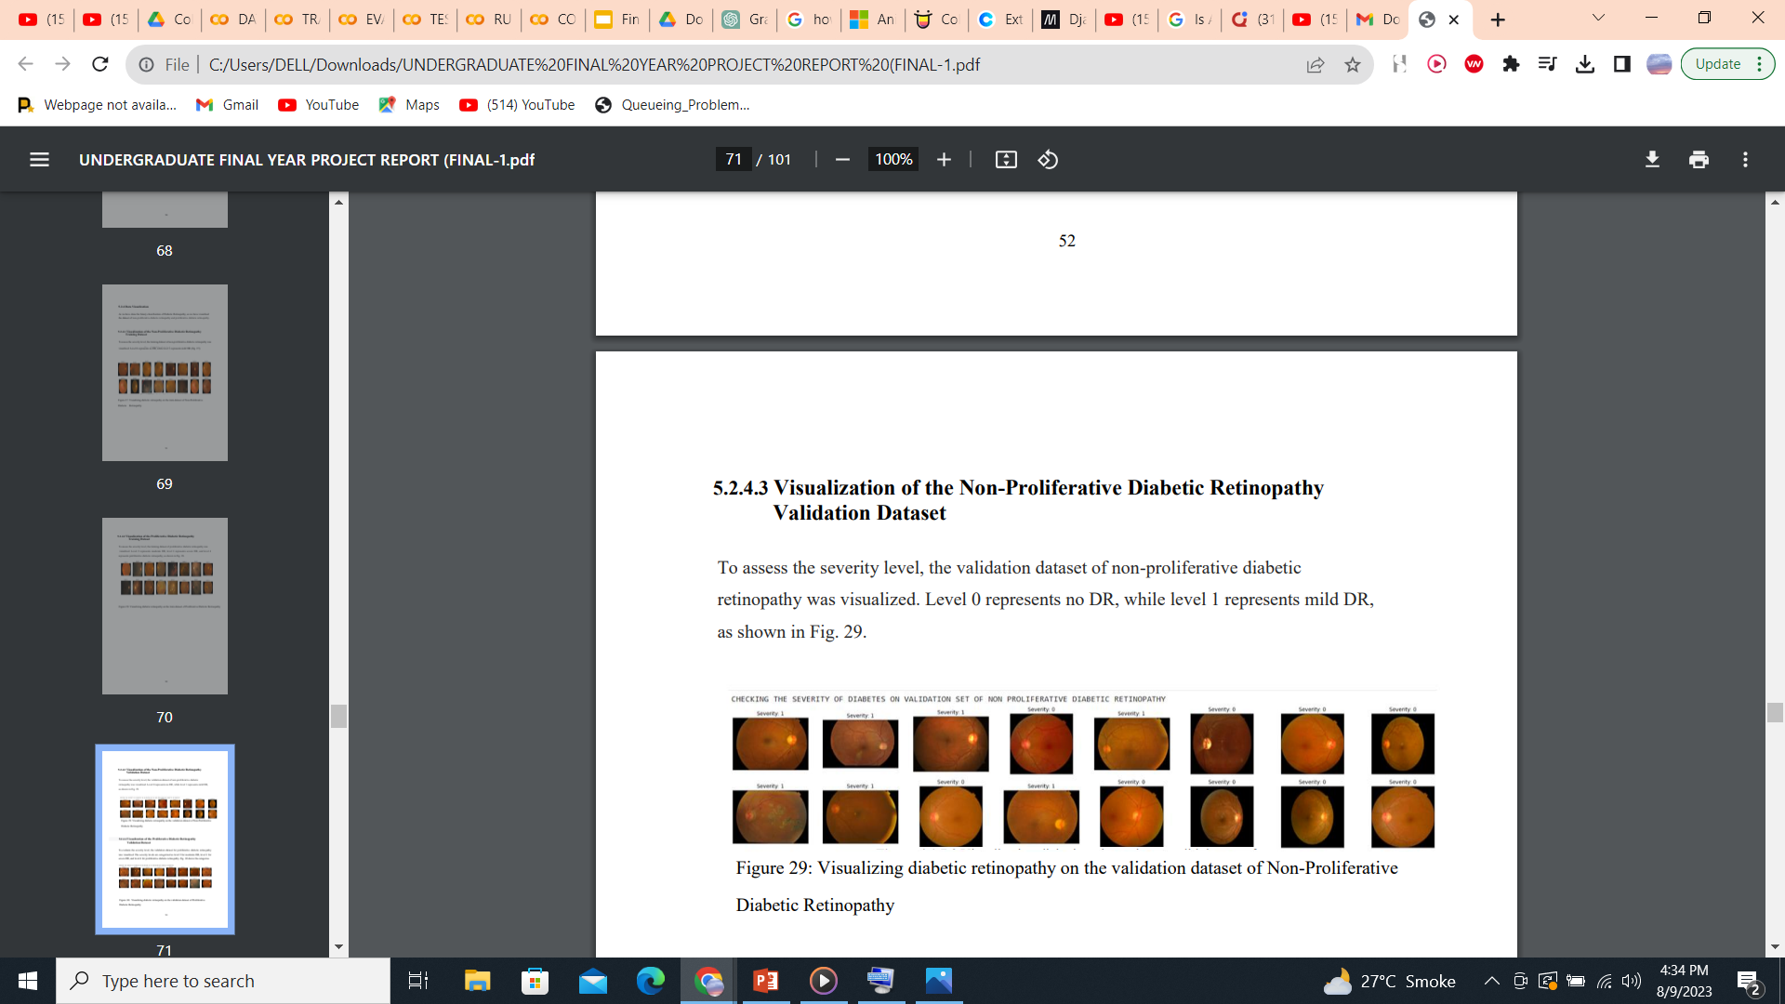
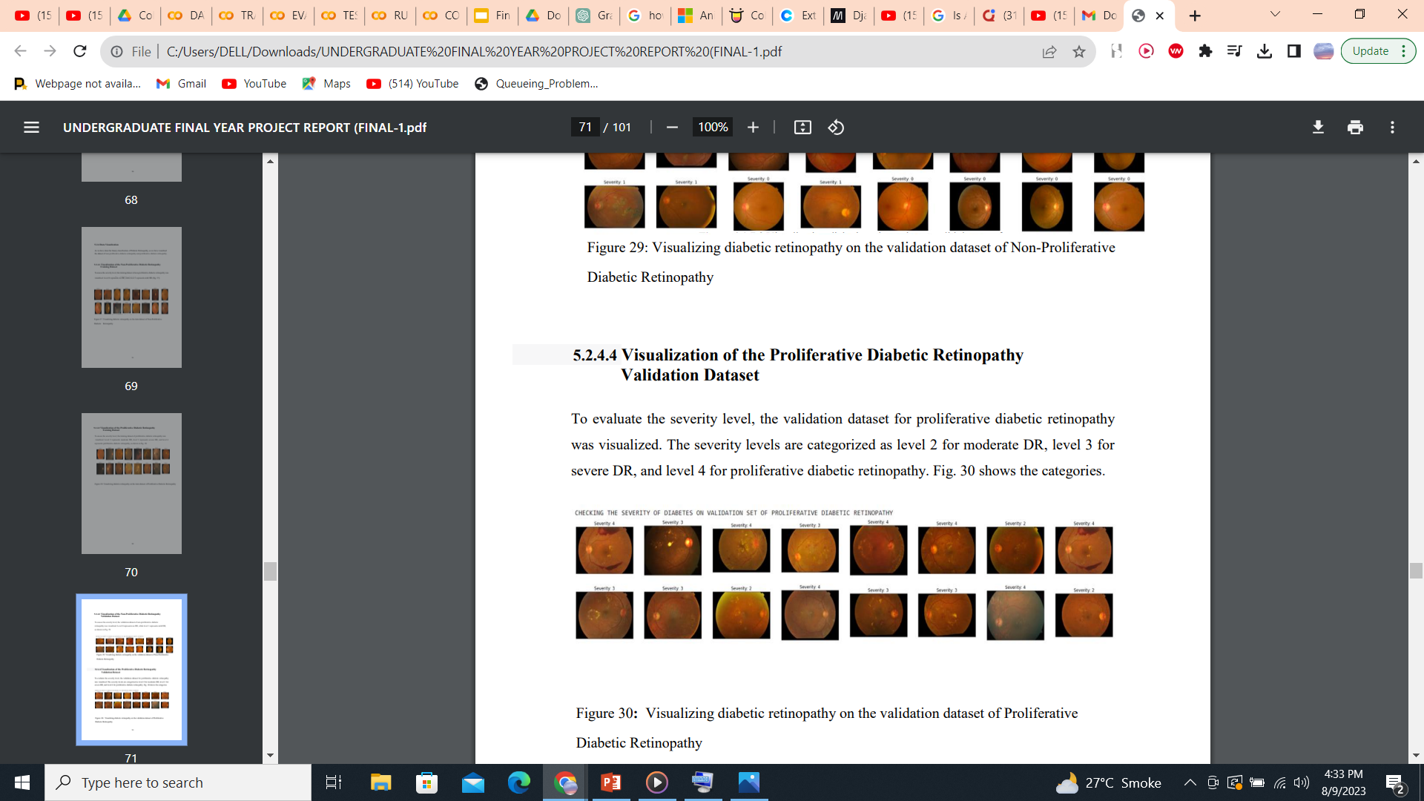
DATA VISUALIZATION
Data Visualization of Proliferative and Non- Proliferative DR Validation Dataset

Slide 10
TRAINING OF AI MODEL
Training of AI Model is done using an optimizer known as “ADAM” which follows gradient descent optimization algorithm which is used to iteratively adjust the model's parameters in order to minimize the loss function, improving the model's ability to make accurate predictions and converge towards better accuracy.
Dataset | Metric | Epoch | Value
Train | Maximum Accuracy | 47 | 87.26
 | Maximum Loss | 11 | 43.72
 | Minimum Loss | 49 | 29.97
Validation | Maximum Accuracy | 37 | 81.75
 | Maximum Loss | 1 | 51.30
 | Minimum Loss | 40 | 38.11

Slide 11
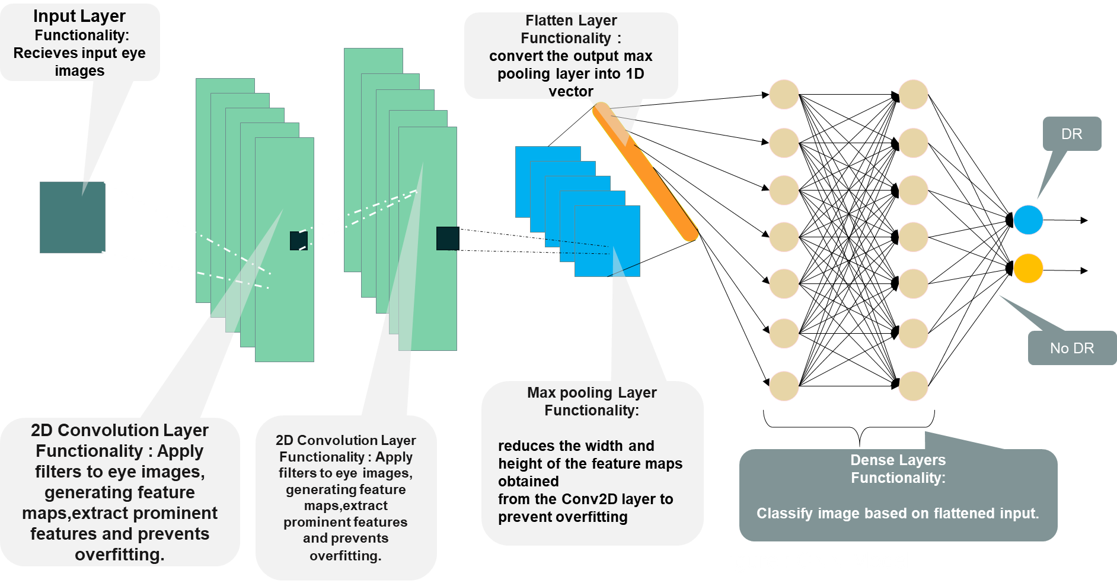
AI MODEL SELECTION

Slide 12
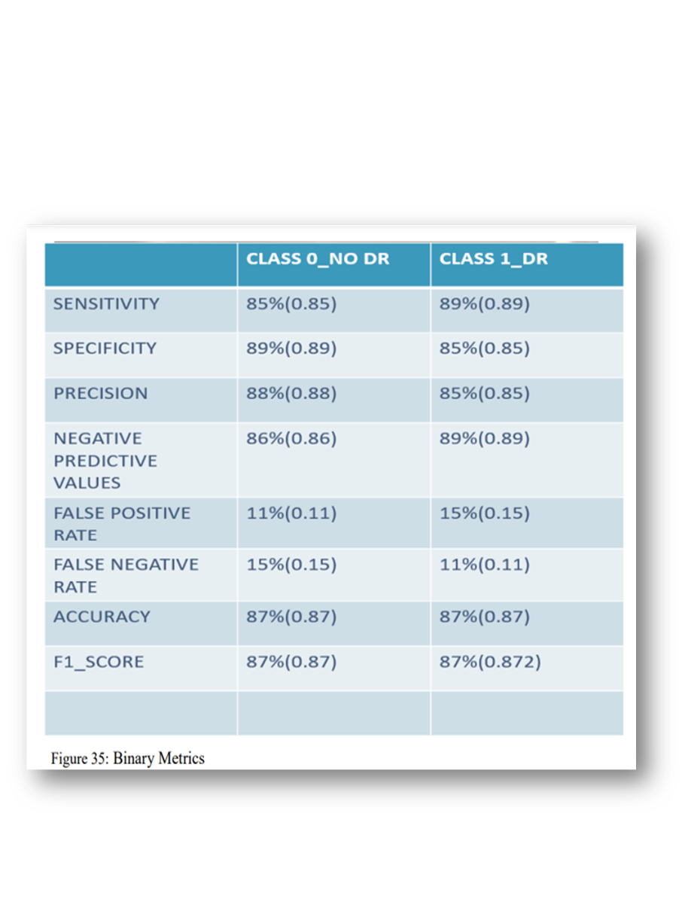
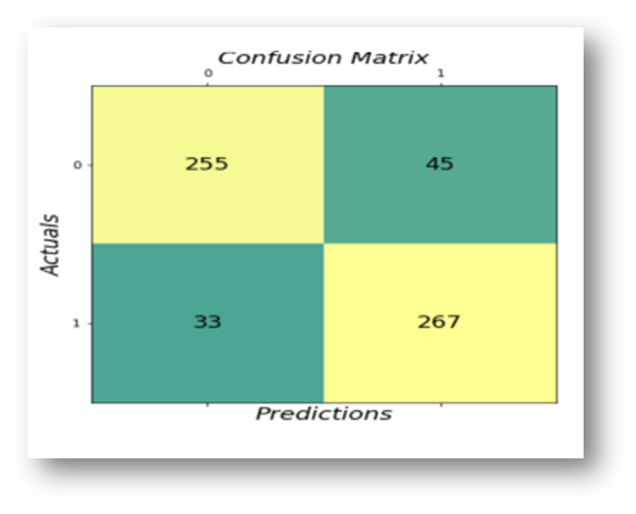
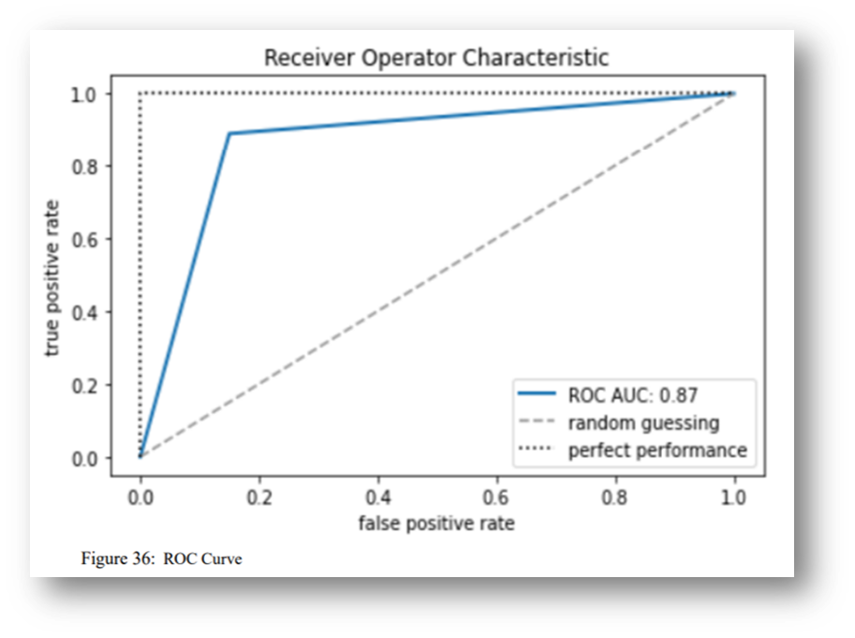
VALIDATION OF THE AI MODEL
Validation of an AI Model can be done through following ways.
BINARY METRICS
CONFUSION MATRIX
ROC CURVE

Slide 13
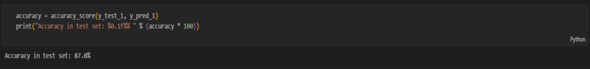
TESTING THE AI MODEL
The accuracy obtained after testing AI Model is 87%.

Slide 14
EVALUATING AI MODEL ON GPU AND CPU
Metric | GPU | CPU | GPU vs CPU
Memory Utilization | 15% | 6.58% | When running on a GPU, the AI model uses more memory as compared to when it runs on a CPU.
Latency | 1.925 seconds | 2.374 seconds | The AI model has shorter processing delay when executed on a GPU compared to a CPU.
Bandwidth | 6.6037GHz | 4.66 GHz | When the AI model runs on a GPU, it has higher data transfer rates (bandwidth) between components compared to when it runs on a CPU.
Power | 27.45 Joules/sec | 15.33 Joules/sec | When the AI model runs on a GPU, it consumes more electrical power than when it runs on a CPU.
Clock Rate | 1.59 GHz | 2.25 GHz | When the AI model runs on a GPU, its processing cores operate at a higher clock rate than when it runs on a CPU.
Accuracy of AI Model | 87% | 87% | Accuracy when run on GPU and CPU is same.

Slide 15
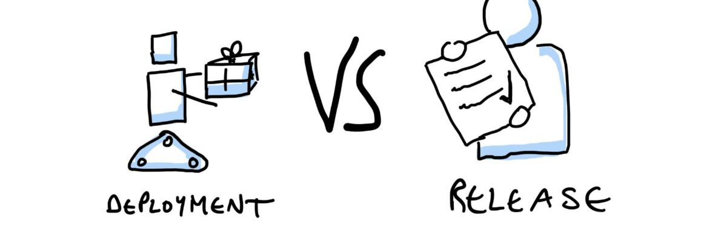
DEPLOYMENT OF AI MODEL

Slide 16
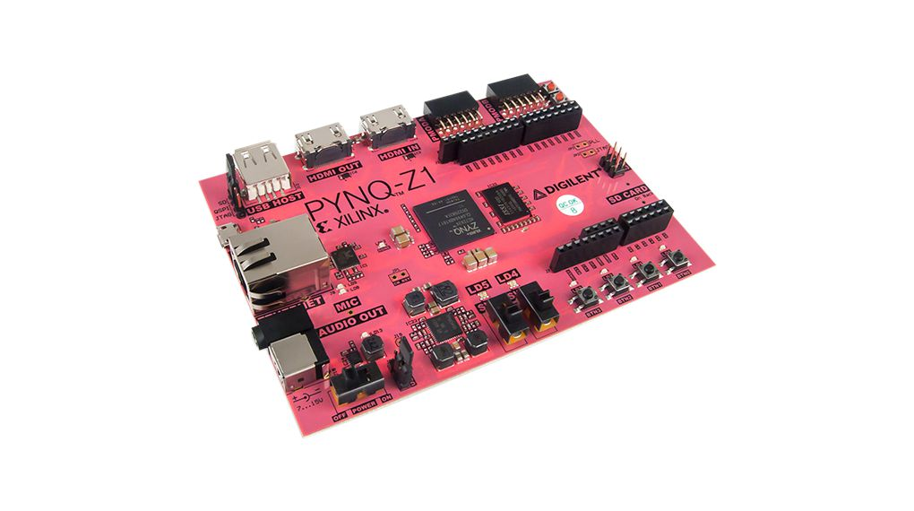
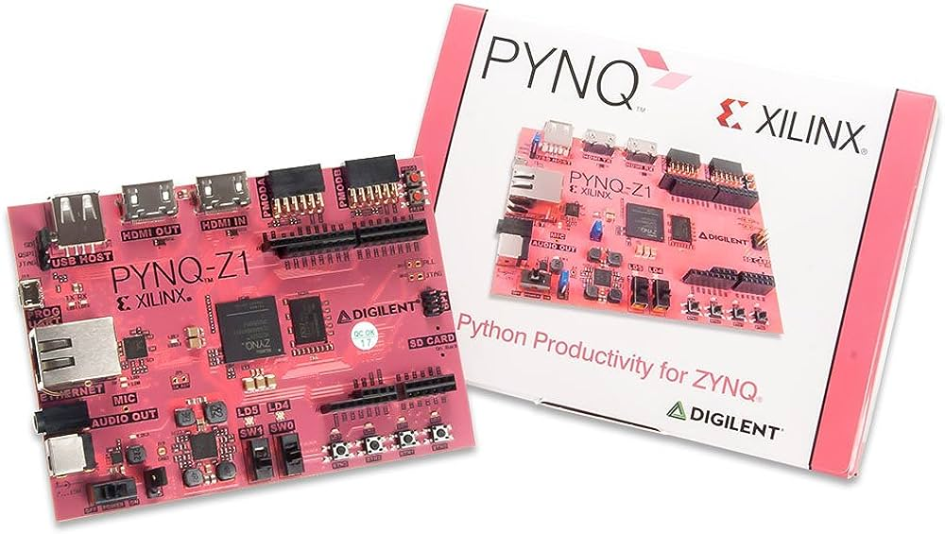
Platform Description PYNQ-Z1 (Python Productivity for Zynq)
Processing Unit:
Xilinx Zynq-7000 SoC (System-on-Chip):
Dual-core ARM Cortex-A9 processor
Programmable logic (FPGA) with Artix-7 FPGA fabric
Memory:
512MB DDR3 RAM
Storage:
microSD card slot for additional storage
Power:
5V power supply through microUSB connector
Operating System:
Supports Linux operating system

Slide 17
EFFICIENCY OF PYNQ-Z1 TO NVIDIA RTX 3090 24GB
Feature | PYNQ-Z1 | Intel Core i7-12700K, 64GB DDR4 Ram @ 3200mhz, Nvidia RTX 3090 24GB
Power Consumption | 2-5 watts | 250 watts
Energy Consumption | 20-50 watt-hours | 600 watt-hours
Cost | $100 | $3000
Performance | 100-200 GFLOPS | 40 TFLOPs
Memory | 512MB | 24GB
Flexibility | High | High
Support for AI frameworks | PyTorch, TensorFlow | PyTorch, TensorFlow, Caffe, MXNet

Slide 18



SETUP AND PREPARING PYNQ-Z1 (Python Productivity for Zynq)
PYNQ Image
TensorFlow Library
PIL (Pillow) Library
NumPy Library
os Library (Operating System Interaction)
Time Library

Slide 19
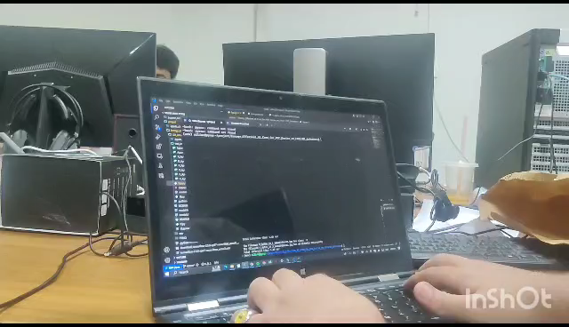
INFERENCE First Inference of the AI Model on PYNQ-Z1 through SSH session in the shell

Slide 20
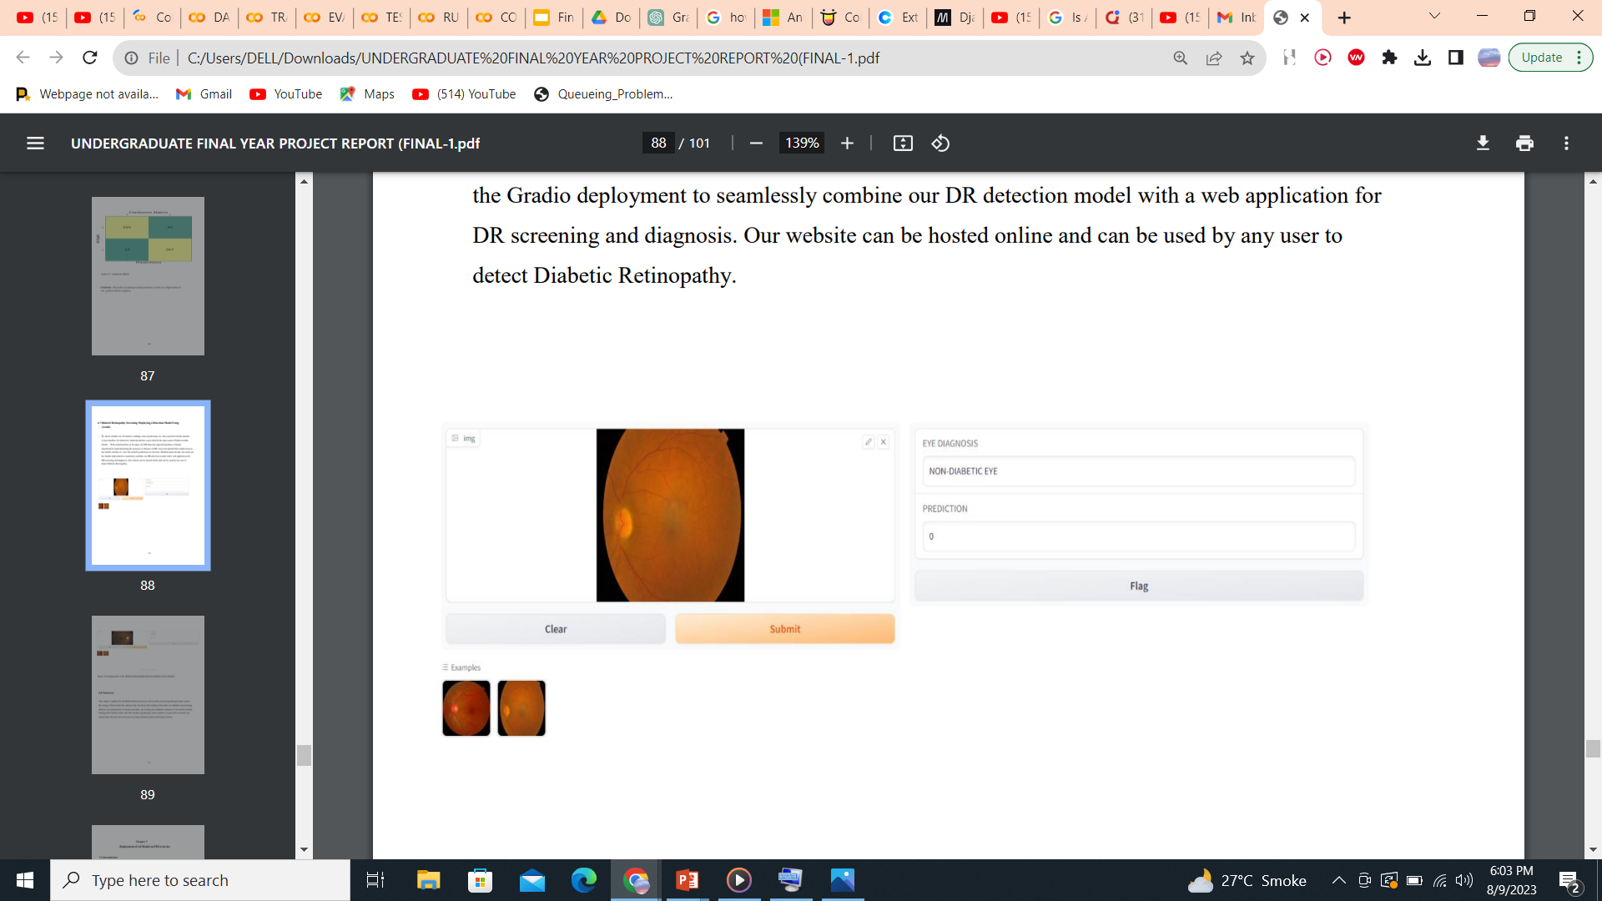

SIMPLE DEMO OF THE INFERENCE IN PYNQ-Z1USING (GRADIO)
User Interaction:
Gradio enables users to interact with machine learning models without needing to write any code.
Input Variety:
Gradio supports various input types such as text, images, audio, and more. This versatility enabled us to create interfaces for our AI model deployed in PYNQ-z1
Visualization:
It allowed us to display model predictions, in a visually appealing manner, enhancing user understanding and engagement.

Slide 21


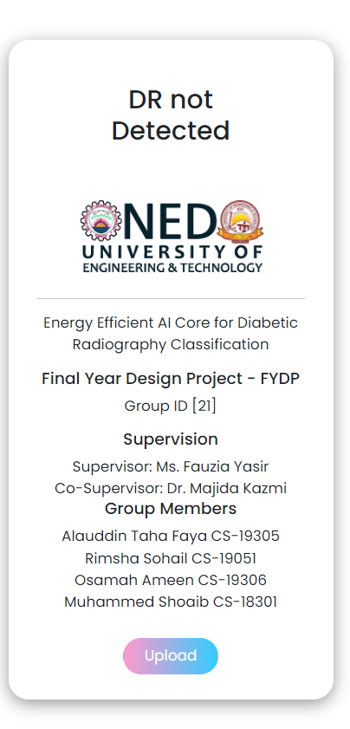
AI MODEL AS SERVICE HOSTED ON PYNQ-Z1
Installation of Django in PYNQ-Z1:
PYNQ-Z1 typically operates on Linux OS. While it's possible to install and run Django on Linux.
Offline Operation:
Application hosted on the PYNQ-Z1 can operate even when the internet connection is down, ensuring connectivity of PYNQ and POC to the LAN without relying on external servers.
Django:
A function of Django in the view.py file was used to load the model and receive the image from the HTML and render the prediction back to the HTML.
Python was mainly used for running the model
HTML, CSS and JavaScript was used to create the user friendly UI

Slide 22

ACCESSING THE SERVIEC Executing the function runserver of the manage.py of the project at port number 0.0.0.0.8000 The service can be access using the IP address assigned by the router to the pynq board

Slide 23
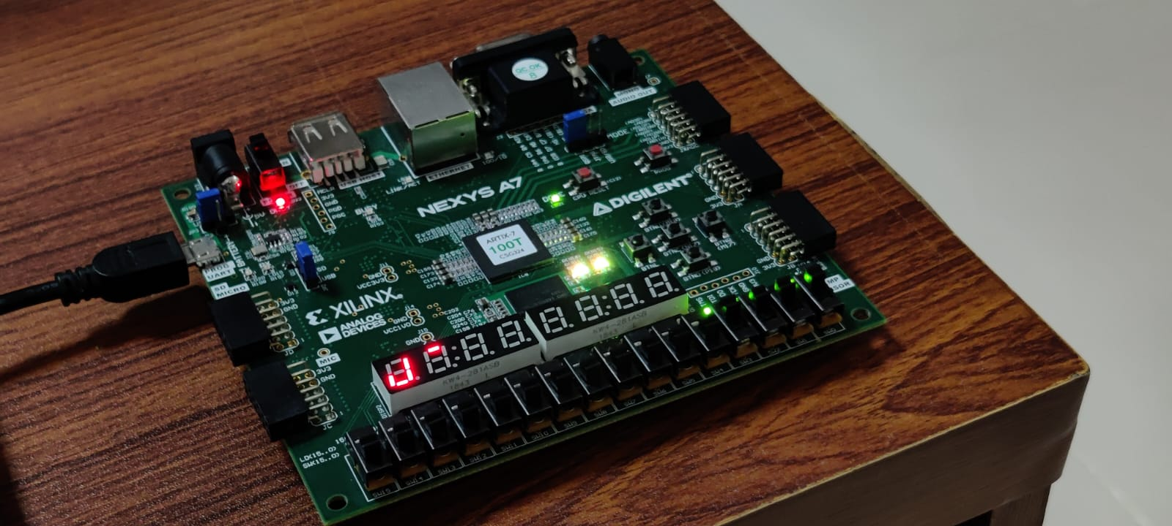
Optimization and Enhancement Research

Slide 24
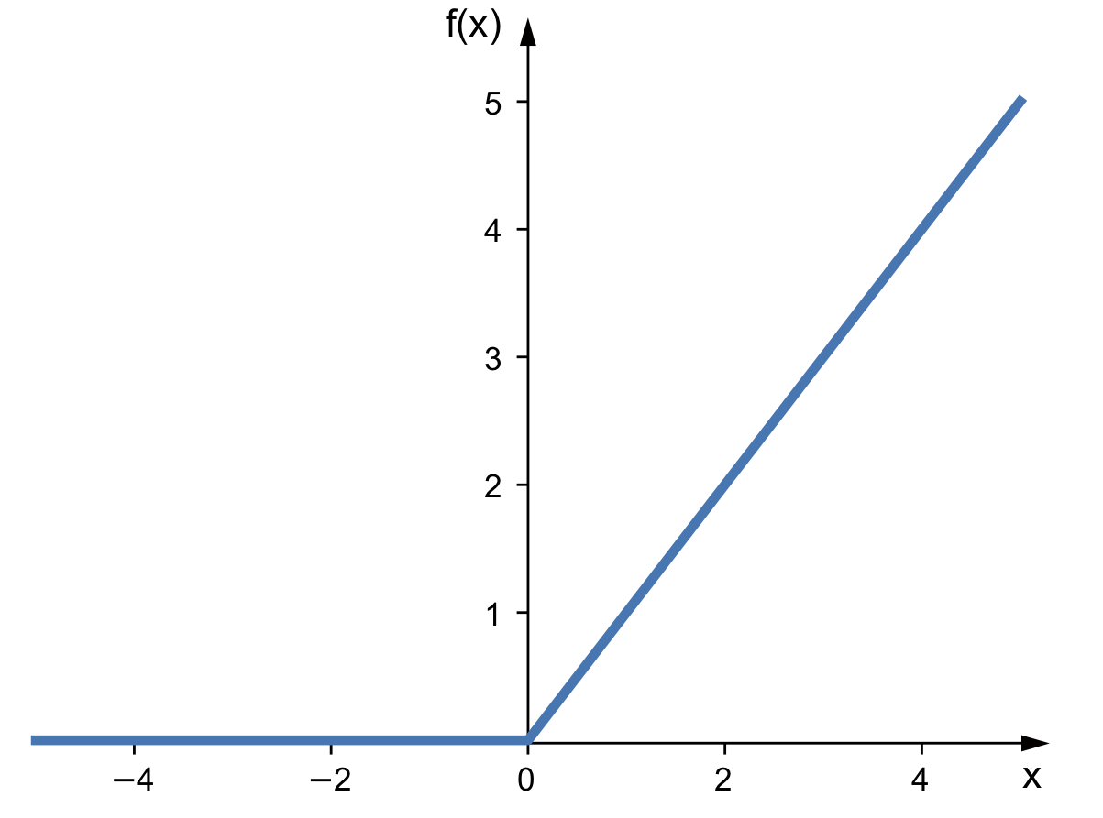
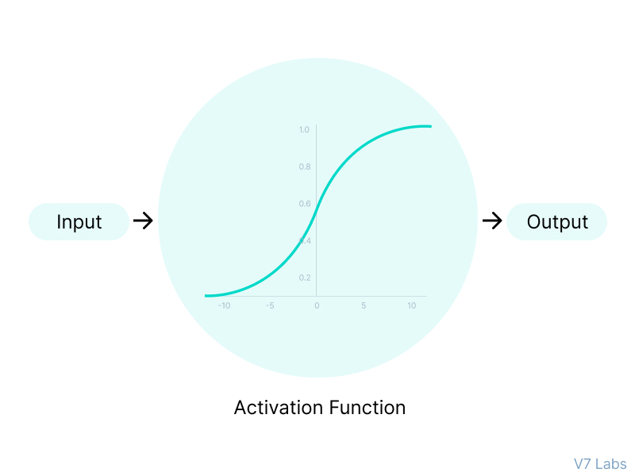
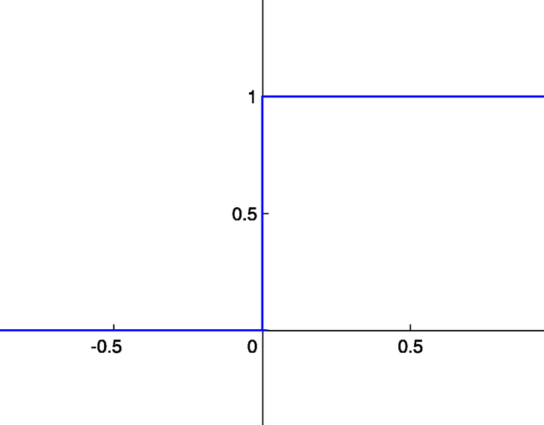
ACTIVATION FUNCTIONS IN HARDWARE
ReLU Activation Functions:
It involves a simple comparison operation between the input and zero, followed by a multiplexer that selects either the input or zero as the output.
Hard Limit Activation Functions:
It involves a simple comparison operation between the input and zero, followed by a multiplexer that selects either the one or zero as the output.
Sigmoid Activation Functions:
Sigmoid Function Implementation has Challenges due to its Non-linearity and high degree of precision and memory requirement

Slide 25
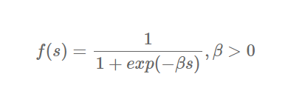
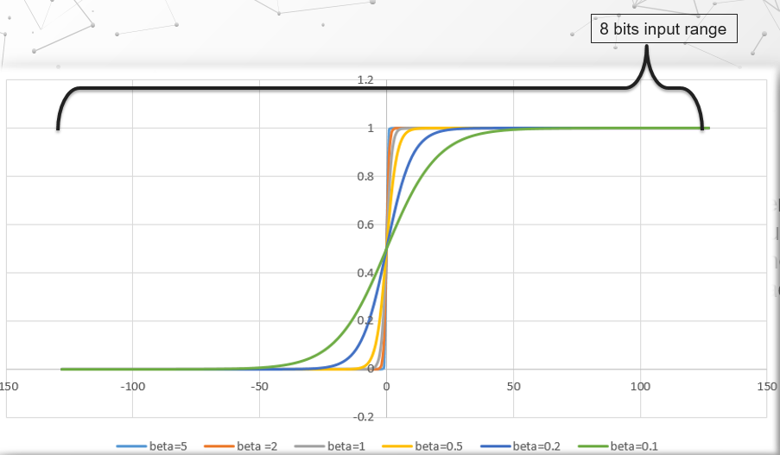
APPROXIMATION OF SIGMOID ACTIVATION FUNCTION
Input of 8-bits
Beta Value to 0.1
Round up the output
Rounding up the output of sigmoid activation function will help to reduce the precision with acceptable tradeoff in the accuracy
Means the range of all possible input is (-128➔127)
Small dissension curve that range between the values 7 to -7
The best Beta value has been selected as a temperature of the neuron

Slide 26
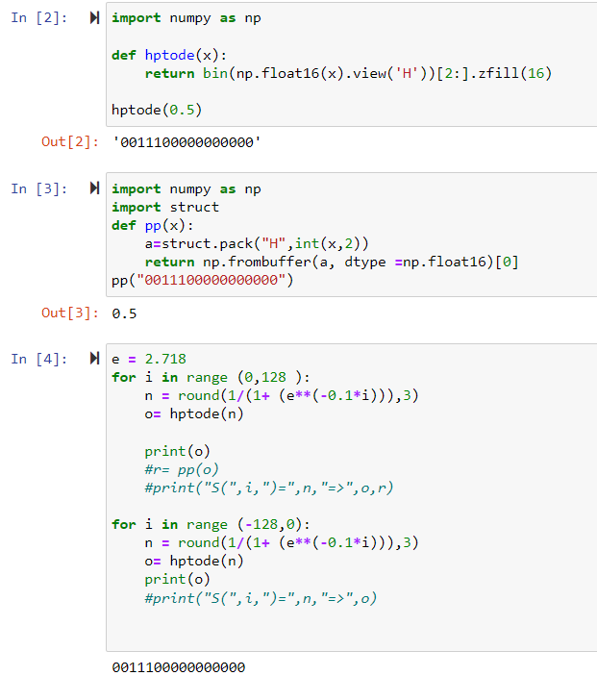
SIGMOID ACTIVATION FUNCTION IMPLEMENTATION IN BRAM
Python code to calculate the response of the sigmoid activation function with a Beta value of 0.1.
Output of the sigmoid activation function was converted to IEEE 754 single-precision 32-bit format using the struct library of python.
Rounding up to nearest three floating points in order to quantize the values and make sure the output remain in the range of IEEE 754 format.

Slide 27
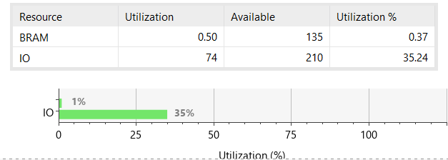
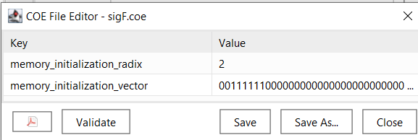
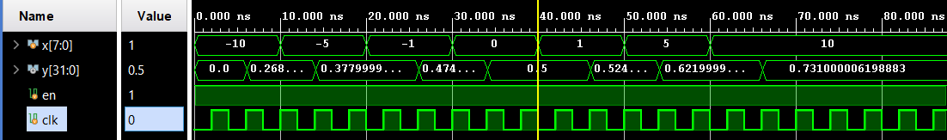
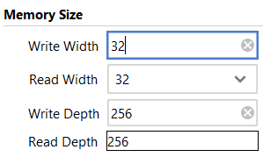
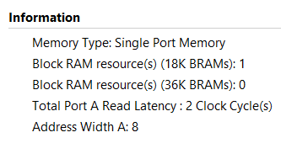
BRAM CONFIGURATION & ANALYSIS
A single sigmoid activation function was set to be 2^(8) * 32 = 8192 bits as shown in Figure 10, that is equivalent to half of an 18 Kbit BRAM
pre-calculated values by the python code were stored in CEO file and loaded to BRAM

Slide 28
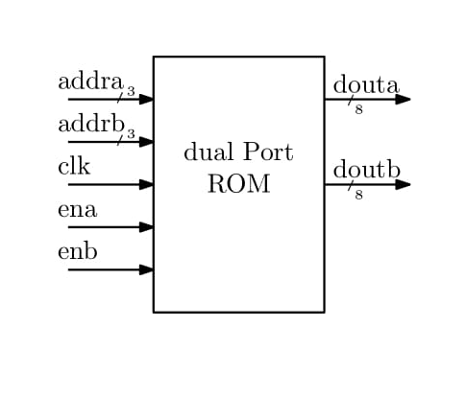
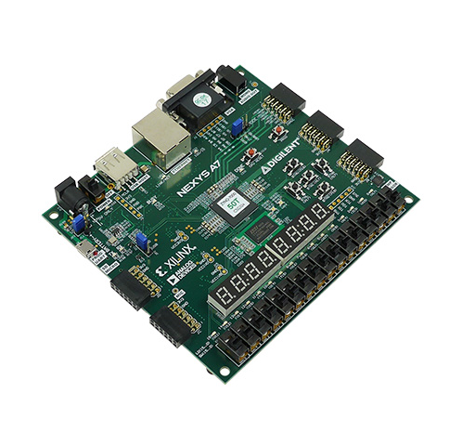
BRAM OPTIMIZATION
A single BRAM can be configurable to be a Dual Port ROM in which it will have two data output which will enable us to fetch two locations per cycle.
We have done further optimization to increase the bandwidth using Overclocking technique fetching 4 result of sigmoid activation function in a single cycle .
A single 18K BRAM is utilized for the configuration.
2^(8) is the number of location.
16 bits is the size of each location.
Sigmoid activation function values are placed in the BRAM using COE file in binary format.

Slide 29
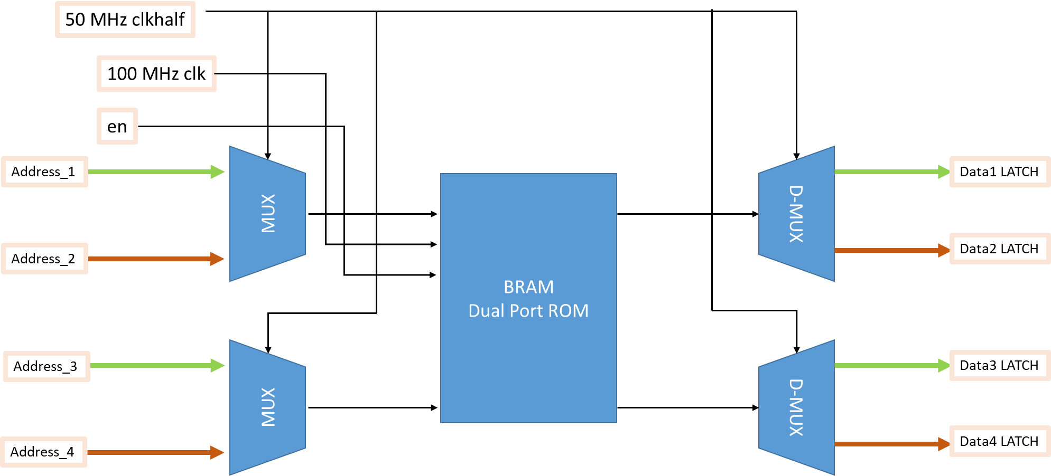
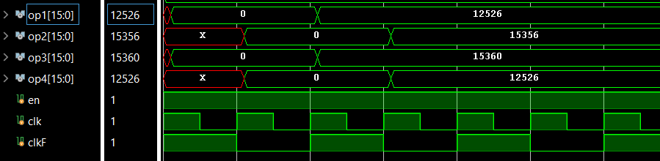
OVERCLOCKING TECHNIQUE

Slide 30
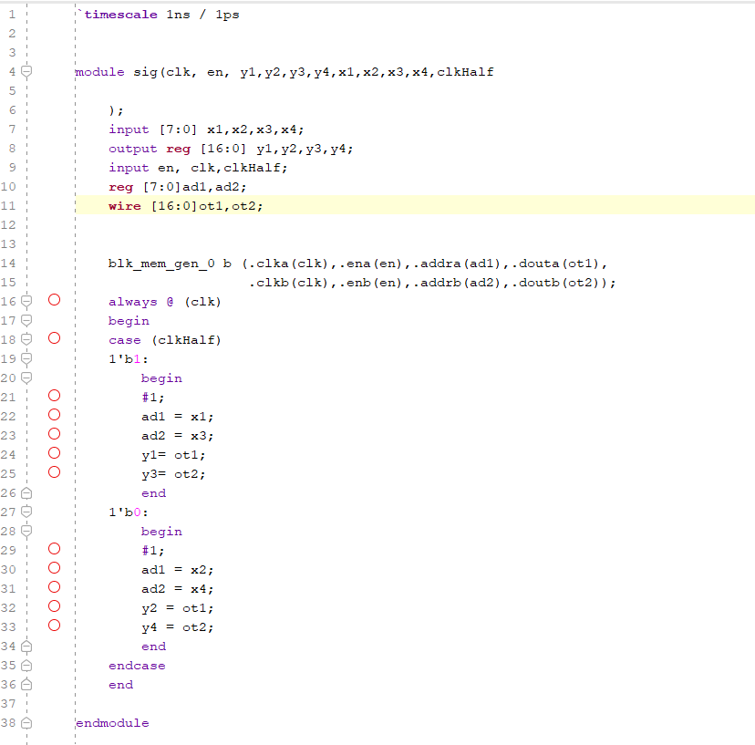
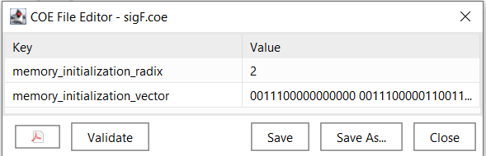
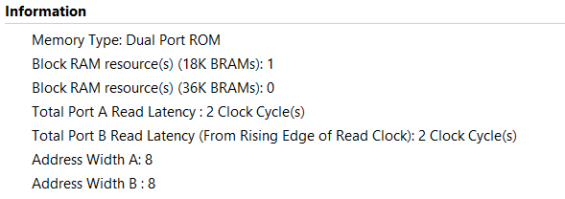
LOGIC OF OVERCLOCKING AND BRAM CONFIGURATION
Summery of BRAM configurations

Slide 31
SIMULATION WAVEFORM
An enable line is for the whole module (en)
Two clock frequencies are provided to the module, clk and clkF where clkF = clk/2.
Main clock is clkF a CMT or Clock wizard can be used for generating these frequencies
op1 and op2 are produced in the positive edge of the cycle.
op2 and op4 are produced in the negative edge of clkF

Slide 32
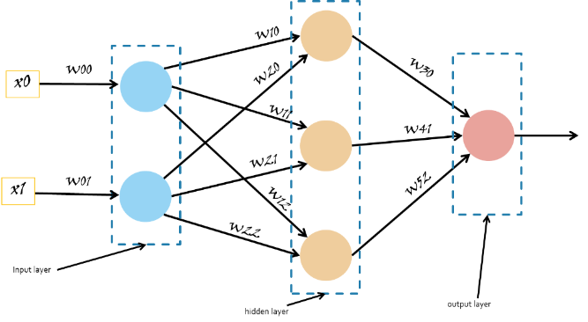

Activation Function
32

Slide 33
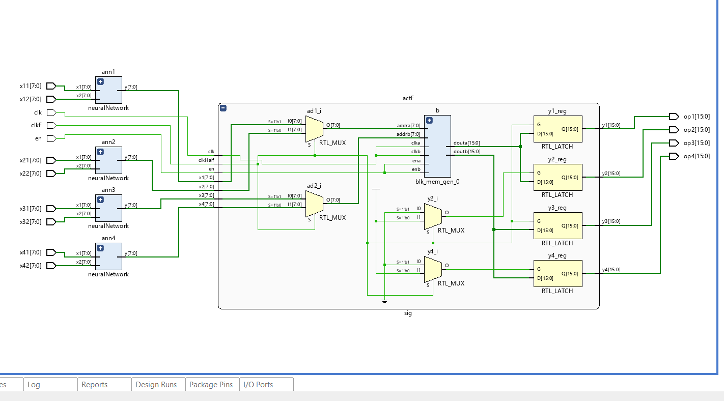
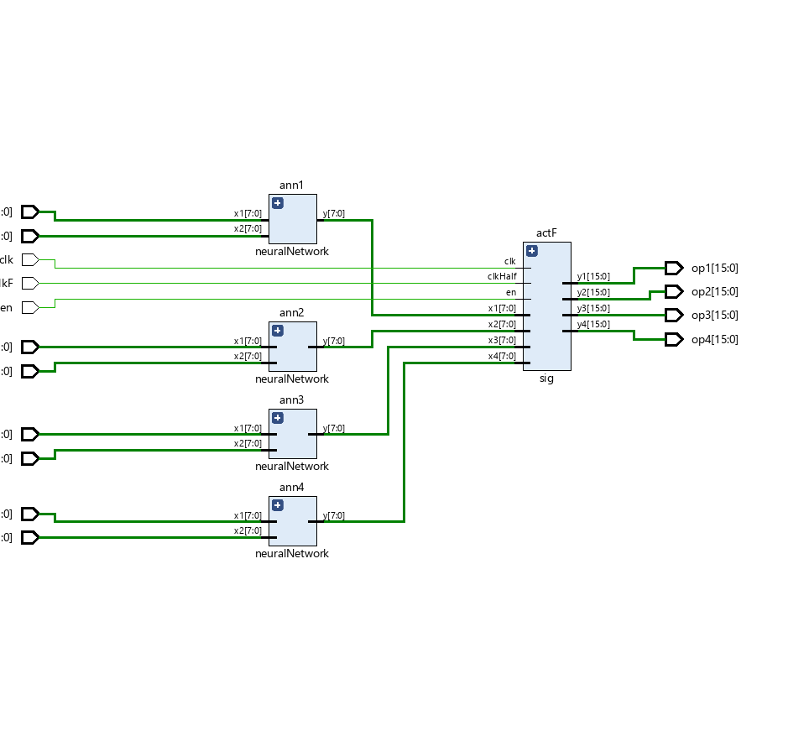
RTL OF OVERCLOCKING TECHNIQUE
A single block having the functionality of producing output of 4 sigmoid activation function in a single clock cycle.
This block has only a single 18K BRAM.
Four MLPs are depending on overclocking module for their sigmoid activation function.
RTL of MLP in Verilog

Slide 34
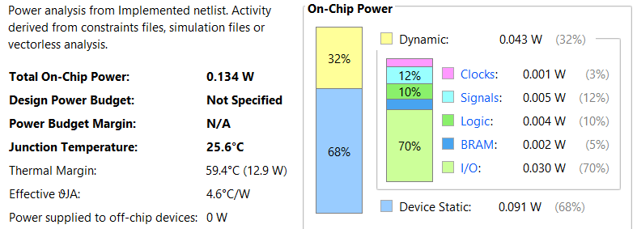
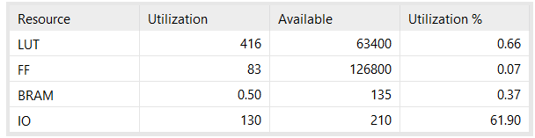
POWER & UTILIZATION REPORTS
Power consumption on FPGA:
Resource Utilization on FPGA:
Utilization Report

Slide 35
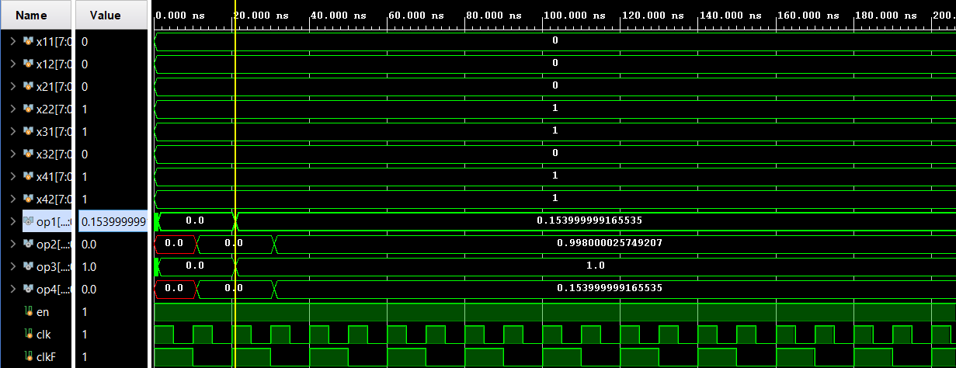
SIMULATION WAVEFORM
A simulation waveform was generated using test bench from which we gave different input combinations to each of the MLP

Slide 36
FINDINGS
Possibility of optimizing the AI model reducing some hidden layer.
Capability of an SoC such as PYNQ-Z1 to run an AI model.
Ability to utilize overclocking for ROM implementation of Sigmoid activation function.

Slide 37
CONCLUSION
DR Classification AI model was trained and achieved 87% accuracy.
Convert the Model into lighter version and infer it PYNQ-Z1 board.
A Simple GUI (Gradio) and Django application of the prediction model were developed, deployed and hosted in PYNQ-Z1.
Optimized the BRAM on FPAG using overclocking technique to increase the bandwidth.

Slide 38
FUTURE ENHANCEMENTS
Integration of overclocking technique with advanced NN for DR detection.
Interfacing of other required component such as camera and screen to make it a stand alone device.
Implementation of different AI application in the area of the retina scans to diagnosis different disease or out of the area scan

Slide 39
THANK YOU
Q&A session

